Slide 1
Saint Ann Catholic School
Uniform and Dress Code

Slide 2
SAINT ANN UNIFORM:
Students in grades K-8 take pride in wearing a school uniform. Saint Ann Catholic School has a Formal Uniform and a Summer Uniform option.
The Formal uniform may be worn year round except for days when students have PE. The Formal uniform MUST be worn by all students after Columbus Day until Easter break.
The Summer uniform may be worn instead of the Formal uniform from the first day of school until Columbus Day weekend, and again from the return of Easter break
until the end of the school year.
All questions or concerns regarding the uniform should be directed to the administration.

Slide 3
SAINT ANN UNIFORM VENDER:
FlynnO’Hara Website:
FlynnO'Hara
FlynnO’Hara Store Location:
Fair City Mall, 8650-19 Main Street Fairfax, VA 22031
FlynnO’Hara Phone Number:
(703) 503-5966

Slide 4
Formal Uniform Grades 6-8

Slide 5
Formal Uniform Grades 6-8
GIRLS:
Pants | Navy pants (worn with white long or short sleeve button down with a collar, neatly tucked in and navy v-neck sweater or sweater vest with school logo)
Skirt | Saint Ann plaid wrap-around kilt (bottom of skirt should fall at the knee)
Shirt | White long or short sleeve button down shirt with a collar (neatly tucked in)
Sweater | Navy v-neck sweater or sweater vest with school logo
Socks/Tights | Black socks or tights (no brand logo)
Belt | Black or navy
Shoes | Solid black shoe
Pullover (optional) | Fleece pullover with school logo

Slide 6
Formal Uniform Grades 6-8
BOYS:
Pants | Navy pants
Shirt | White long or short sleeve button down shirt (neatly tucked in and buttoned to the top)
Necktie | Saint Ann plaid necktie (8th grade boys may wear any tie of their choosing)
Sweater | Navy v-neck sweater or sweater vest with school logo
Socks/Tights | Black socks (no brand logo)
Belt | Black or navy
Shoes | Solid black shoe
Pullover (optional) | Fleece pullover with school logo

Slide 7
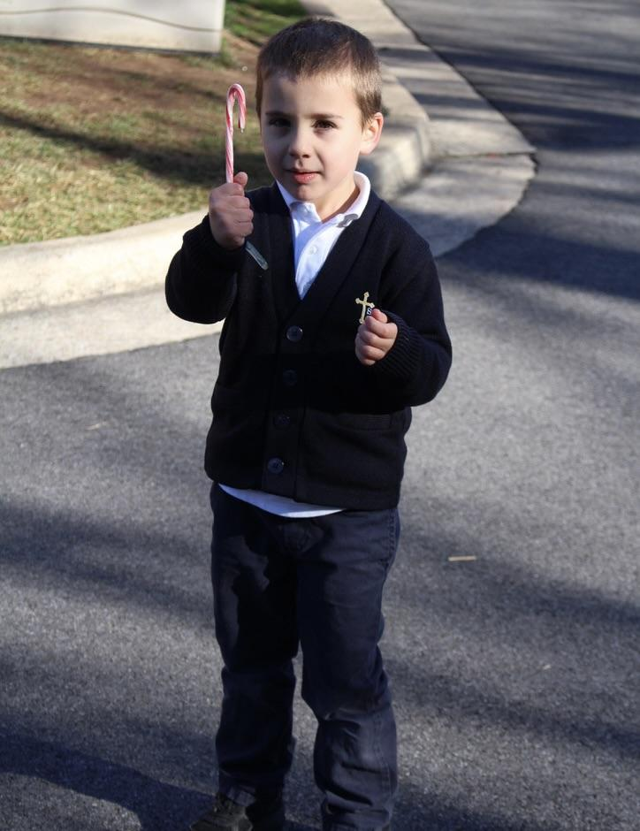
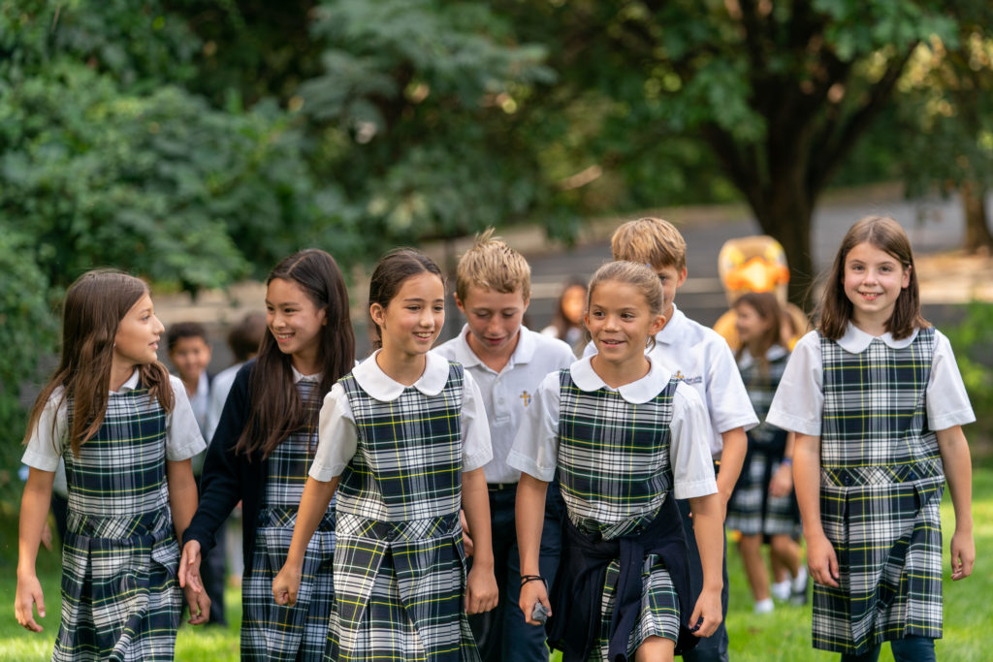
Formal Uniform Grades K-5

Slide 8
Formal Uniform Grades K-5
GIRLS:
Jumper | Plaid drop waist jumper (bottom of jumper should fall at the knee)
Pants | Navy pants (worn with white short or long sleeved Peter Pan collar blouse, neatly tucked in, and navy crew neck or v-neck cardigan with school logo
Shirt | White short or long sleeved Peter Pan collar blouse (buttoned to the top)
Sweater | Navy crew or v-neck cardigan with school logo
Belt | Black or navy (only required for grades 2 - 5)
Socks | Plain black socks or tights (no brand logo)
Leggings | Black ankle length (socks must be worn with leggings)
Shoes | Solid black shoe
Pullover (optional) | Fleece pullover with school logo

Slide 9
Formal Uniform Grades K-5
BOYS:
Pants | Navy pants
Shirt | White short or long sleeved polo shirt with school logo (neatly tucked in)
Sweater | Navy v-neck cardigan with school logo
Belt | Black or navy (only required for grades 2-5)
Socks | Plain black socks (no brand logo)
Shoes | Solid black shoe
Pullover (optional) | Fleece pullover with school logo

Slide 10
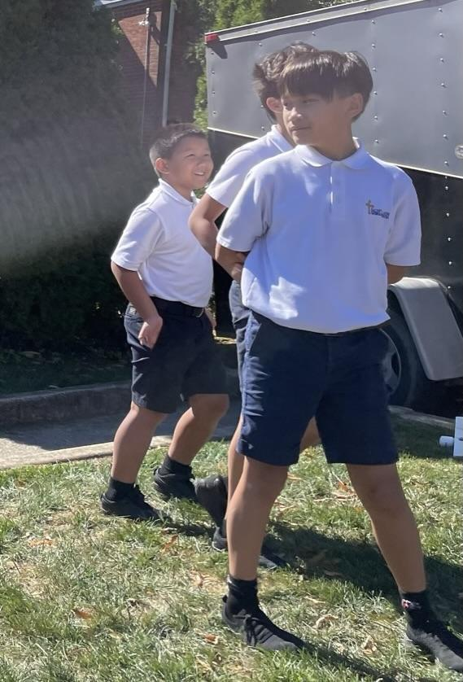
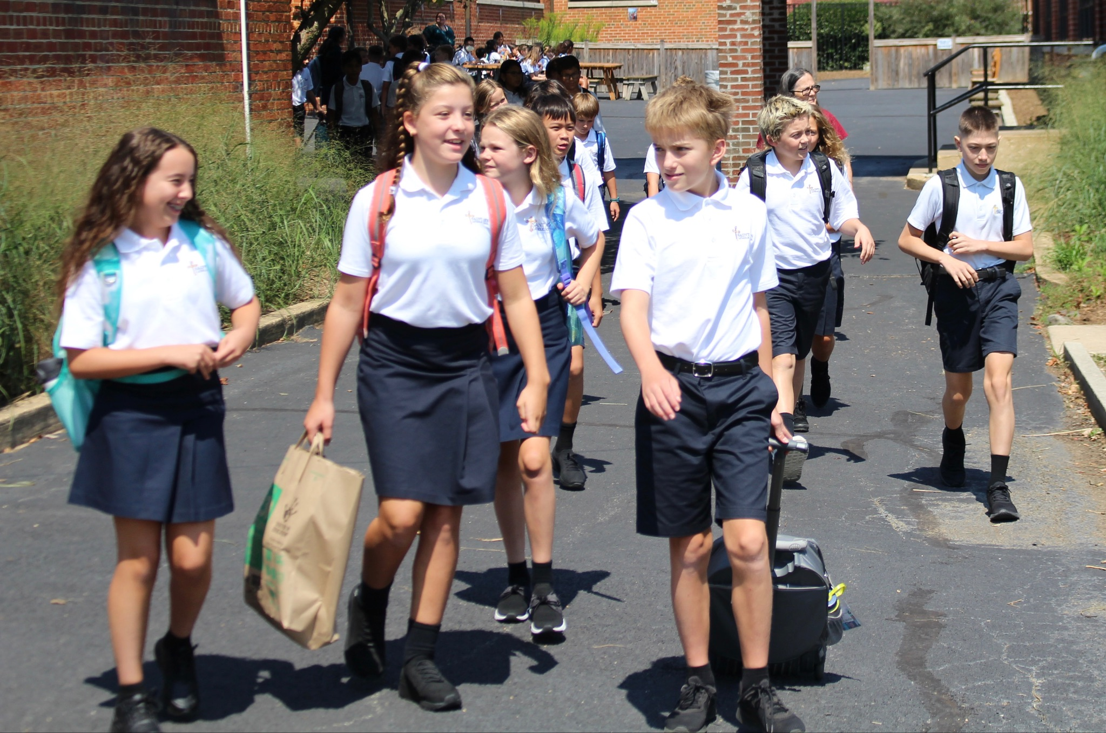
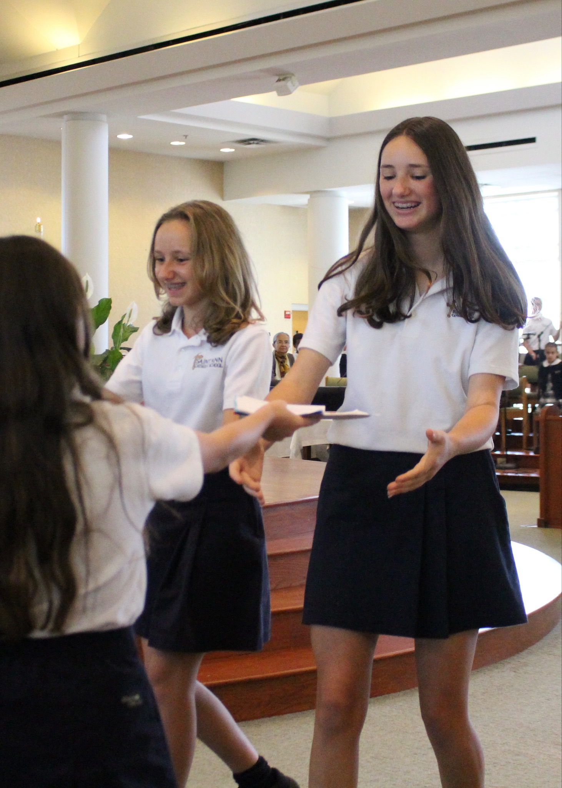
Optional Summer Uniform Grades 6-8
(input pictures here)

Slide 11
Optional Summer Uniform Grades 6-8
GIRLS:
Skort | Navy skort
Shirt | White short or long sleeved polo shirt with school logo (neatly tucked in)
Sweater (optional) | Navy v-neck sweater or sweater vest with logo
Socks/Tights | Black socks (no brand logo)
Shoes | Solid black shoe
Pullover (optional) | Fleece pullover with school logo

Slide 12
Optional Summer Uniform Grades 6-8
BOYS:
Pants | Navy pants or shorts (shorts must be to the knee)
Shirt | White short or long sleeved polo shirt with school logo (neatly tucked in)
Sweater (optional) | Navy v-neck sweater or sweater vest with logo
Socks | Black socks (no brand logo)
Belt | Black or navy
Shoes | Solid black shoe
Pullover (optional) | Fleece pullover with school logo

Slide 13
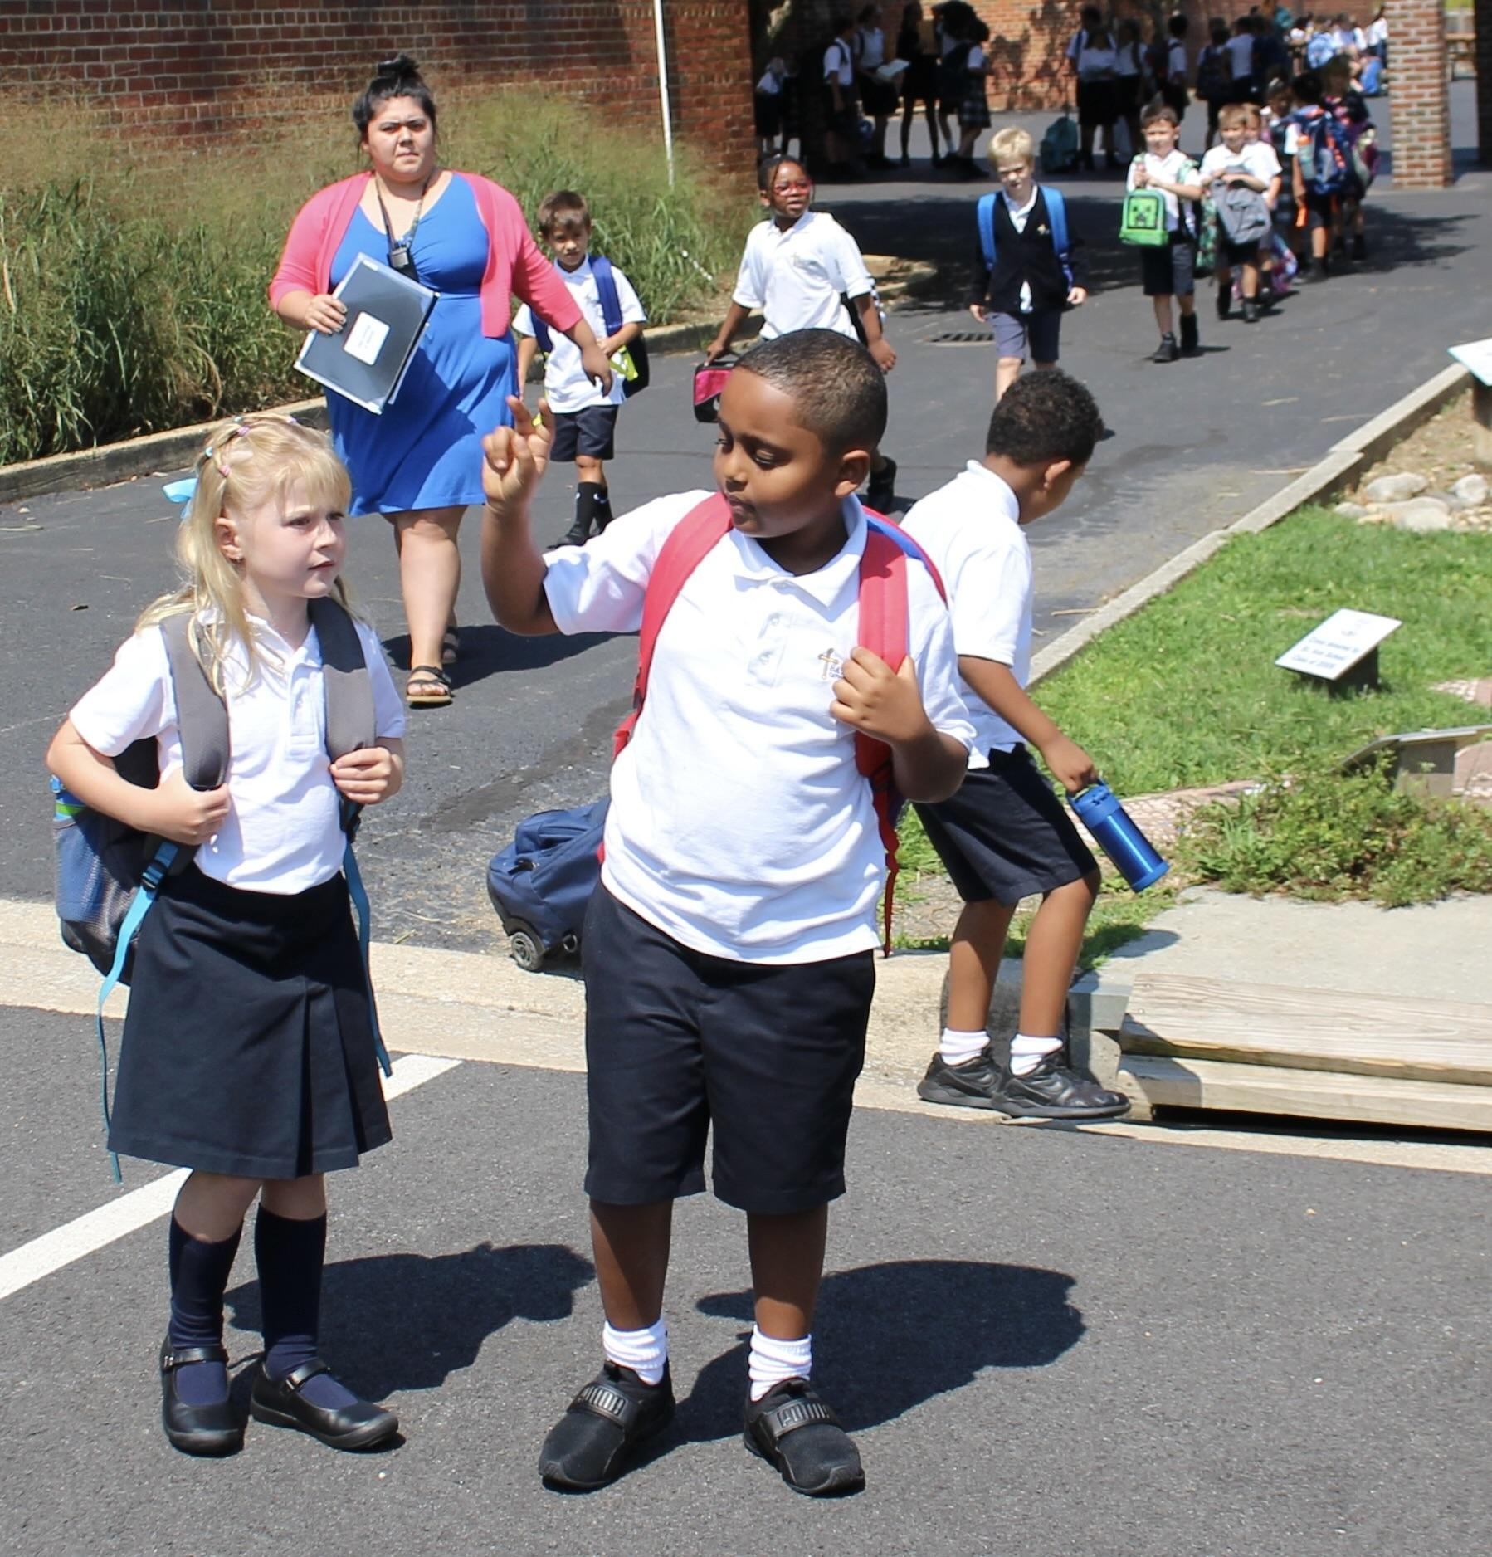
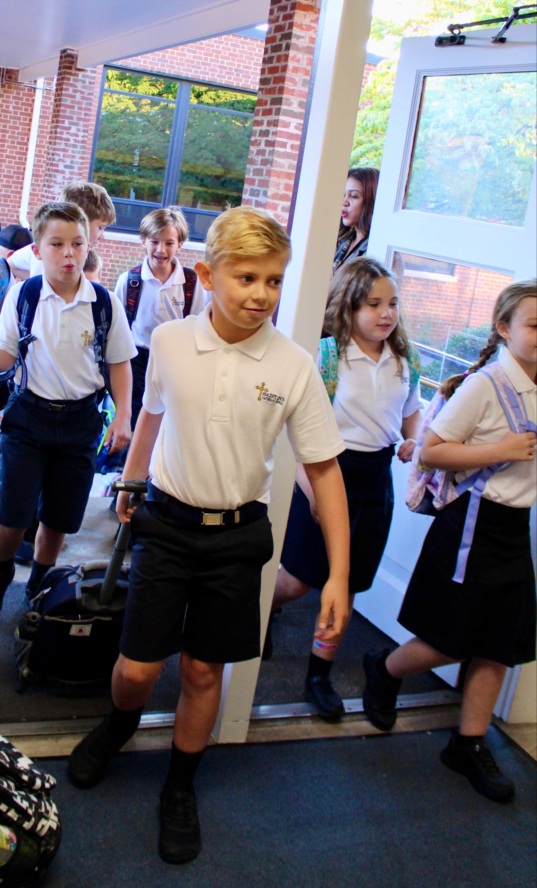
Optional Summer Uniform Grades K-5

Slide 14
Optional Summer Uniform Grades K-5
GIRLS:
Skort | Navy skort
Shirt | White short or long sleeved polo shirt with school logo (neatly tucked in)
Socks/Tights | Black socks (no brand logo)
Shoes | Solid black shoe
Sweater or Pullover (optional) | Sweater: Navy crew or v-neck cardigan with school logo Pullover: Fleece pullover with school logo

Slide 15
Optional Summer Uniform Grades K-5
BOYS:
Pants | Navy pants or shorts (shorts must be to the knee)
Shirt | White short or long sleeved polo shirt with school logo (neatly tucked in)
Socks/Tights | Black socks (no brand logo)
Belt | Black or navy (required for grades 2-5)
Shoes | Solid black shoe
Sweater or Pullover (optional) | Sweater: Navy v-neck cardigan with school logo Pullover: Fleece pullover with school logo

Slide 16
PE Uniform Grades 6-8

Slide 17
PE Uniform Grades 6-8
BOYS AND GIRLS:
Pants | Navy gym shorts or sweatpants with school logo
Shirt | Navy t-shirt with school logo
Sweatshirt | Navy sweatshirt with school logo OR Gray hoodie sweatshirt with school logo
Socks | Black socks (no brand logo)
Shoes | Solid black shoe
*NOTE: Spirit wear is not considered PE attire

Slide 18
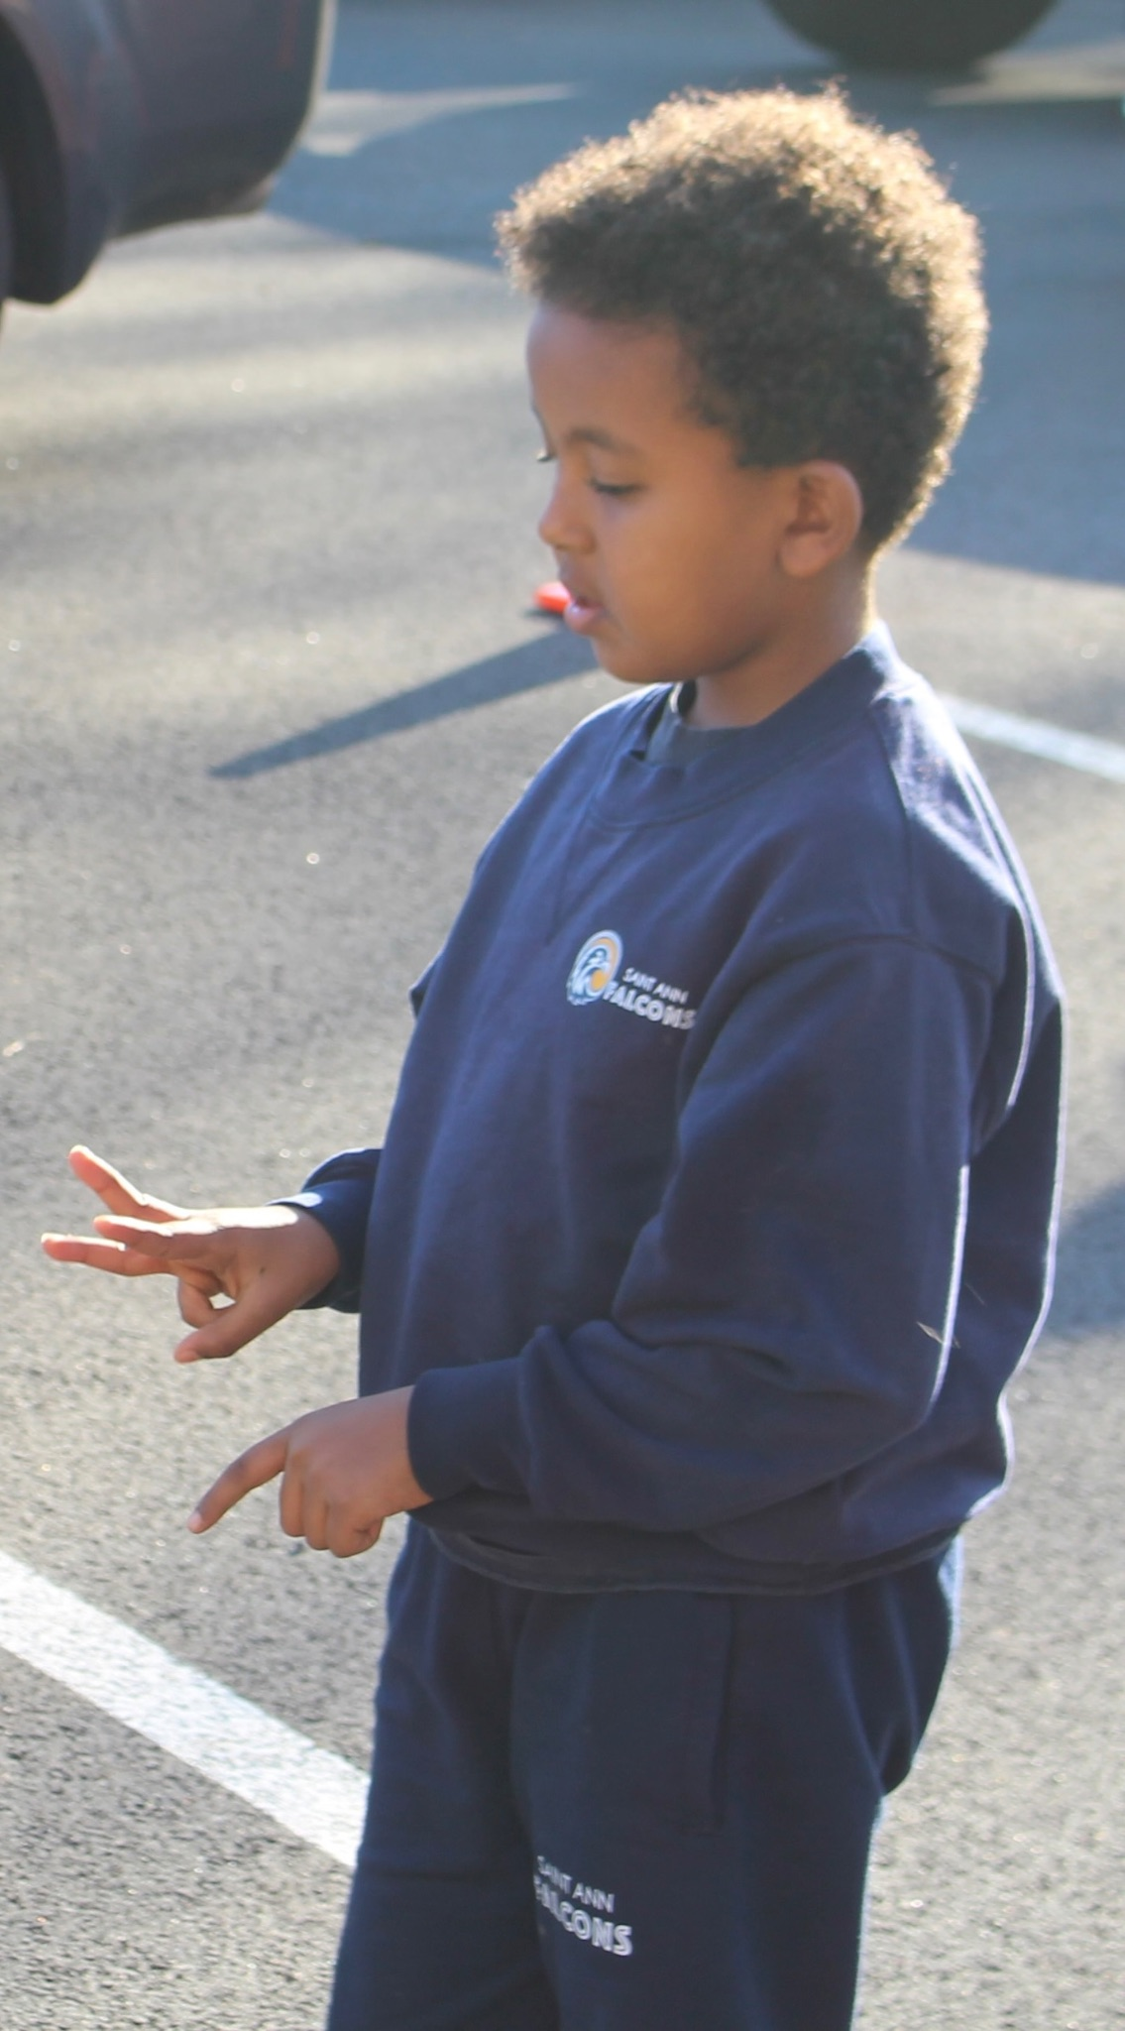
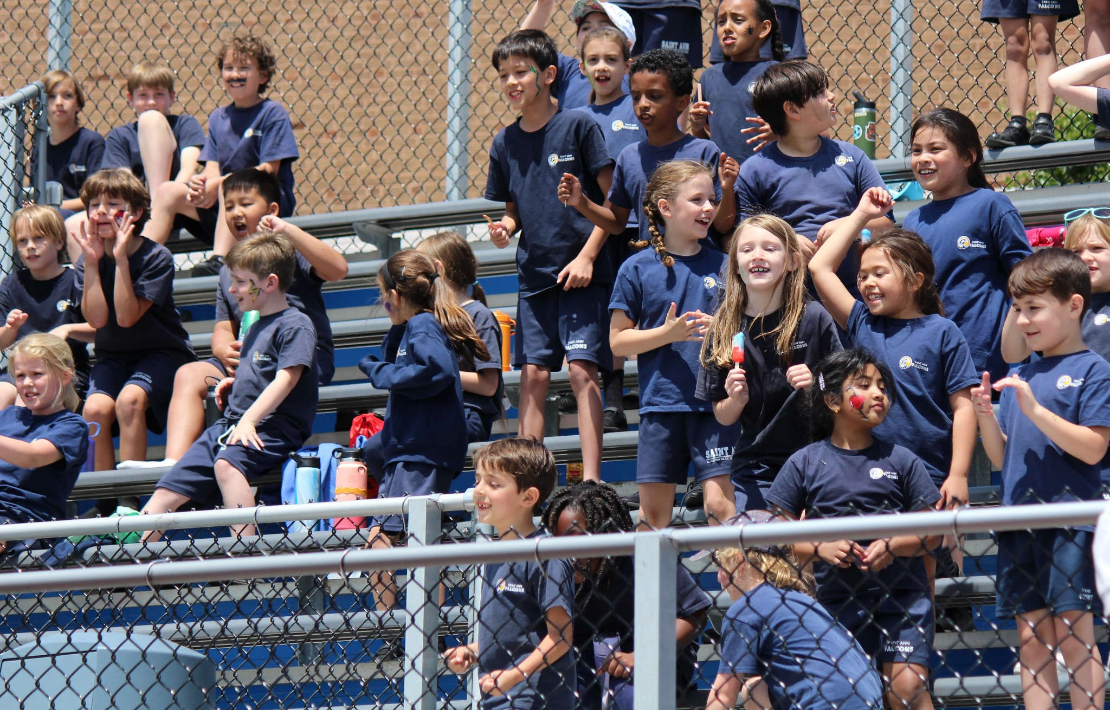
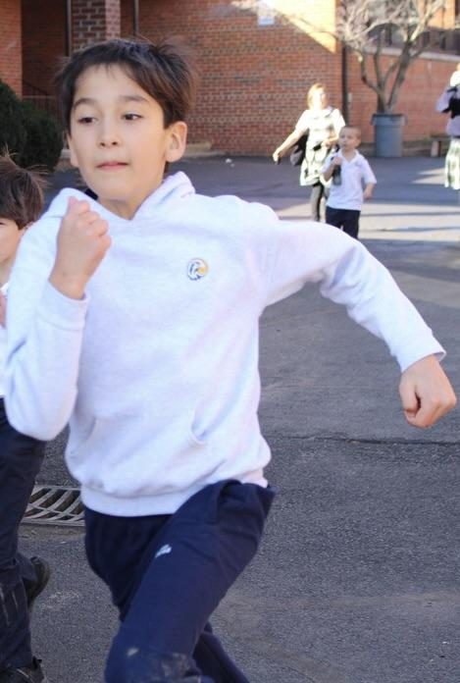
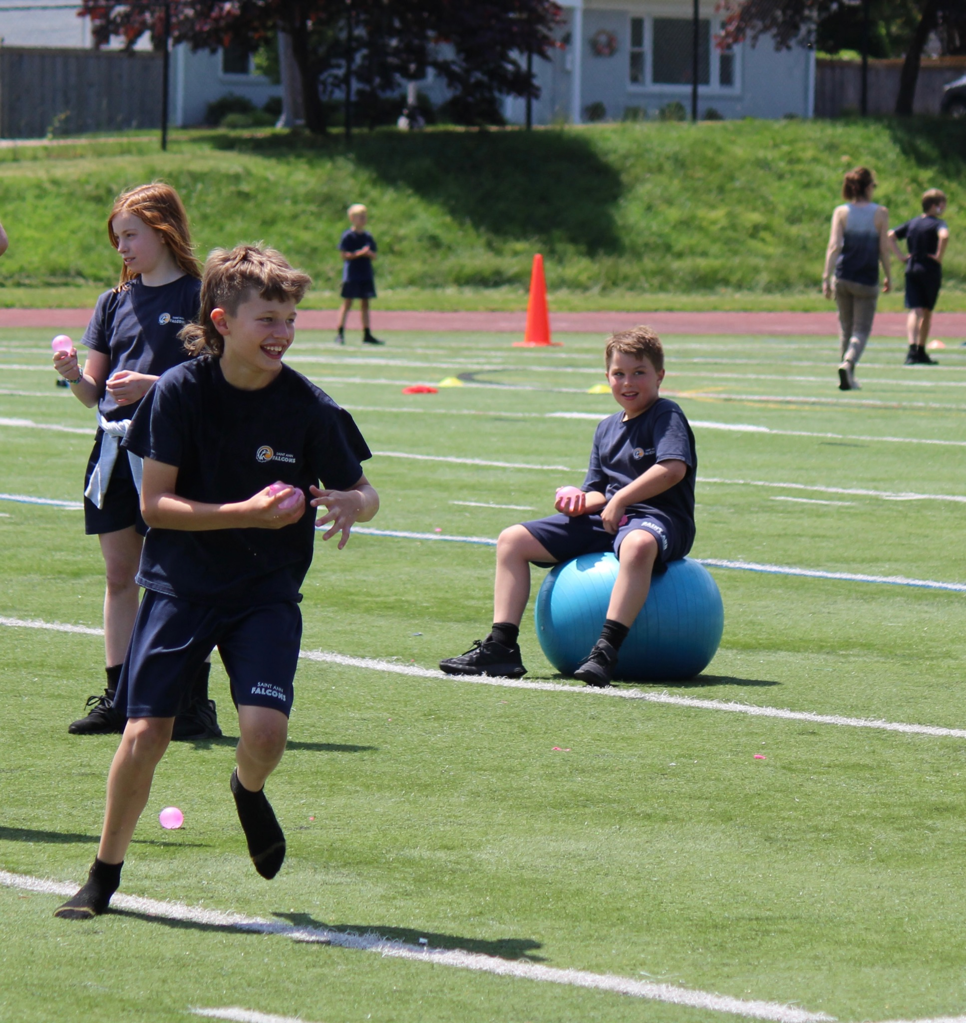
PE Uniform Grades K-5

Slide 19
PE Uniform Grades K-5
BOYS AND GIRLS:
Pants | Navy gym shorts or sweatpants with school logo
Shirt | Navy t-shirt with school logo
Sweatshirt | Navy sweatshirt with school logo OR Gray hoodie sweatshirt with school logo
Socks | Black socks (no brand logo)
Shoes | Solid black shoe
*NOTE: Spirit wear is not considered PE attire

Slide 20
Accessories Grades K-8
BOYS AND GIRLS
Hair Accessories | Headbands, hair ties, etc. Acceptable colors: Saint Ann school plaid, navy, black or white
Earrings | Studs only
Necklaces | One necklace that is religious
Bracelets | None (8th grade girls are allowed to wear one bracelet)
Watches | One watch analog or digital watch (No Smart Watches or Fitbits that have internet access)
Rings | None
Nail Polish | Clear nail polish or no nail polish

Slide 21
Out of Uniform Grades K-8
BOYS AND GIRLS:
Out of Uniform Rules | All clothing should align with Catholic school values. Clothing should not be see through. Clothing should not have holes. Hats may not be worn inside the school building.
Out of Uniform Pass Rules: | Passes may not be used on Mass days. Passes must be used before the expiration date. Passes may not be given to anyone else.

